Slide 1
Digital marketing
services and solutions

Slide 2
Concept and need
2
Businesses need an Integrated
Digital Marketing strategy that is in sync with ever-evolving trends and the changing needs of the organization to achieve enviable y/y growth.
Through the
Ubiquitous
medium - Internet
1
3
Relatively new and
more effective method
of reaching out to
target audience
With relatively
small budget

Slide 3
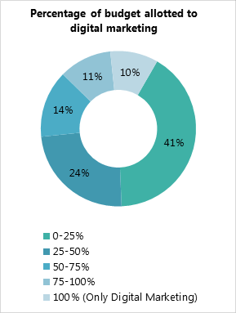
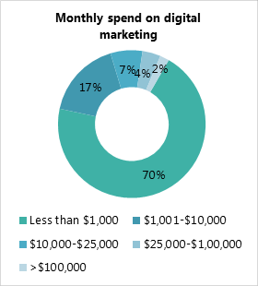
Graphs

Slide 4
How is Digital Marketing Helpful for your Business Growth
Increasing Leads
Focusing on Target
Audience
Promoting Contextual
Marketing
Digital Marketing helps business by
Upping online
presence
Swiftly disseminating
Information

Slide 5
Emerging importance of Digital Marketing
Businesses increasingly gravitating to this technique due to
Upward shift in
purchasing power
Rapid rise in
Dependable home
delivery services
Increased Mobile and
Internet penetration
Preference to Online
Shopping over traditional
brick & mortar bazaars

Slide 6
Why Tvisha
Tvisha Technologies
is a strategic disruptor
in the field of Integrated Digital Marketing
1
Seasoned Professionals
to help through the
maze of marketing.
5
Custom Designed Strategies to elicit
optimal response
to Clients
2
Out of the Box
solutions across
Industry verticals
4
Time-tested and
path breaking
technologies at work
3

Slide 7
WHAT WE OFFER : Digital Marketing Services
Basic Digital to advanced Digital Marketing to swell
Lead generation
Brand Promotion
Online reputation

Slide 8
WHAT WE OFFER : Digital Marketing Services
Search Engine Optimization
Content Marketing
White hat SEO for long lasting
traffic, ranking, lead generation
Content Optimization

Slide 9
WHAT WE OFFER : Digital Marketing Services
Social Media Marketing
FREE Ads
PAID Ads
Facebook
Twitter
LinkedIn
Pinterest
Facebook
Twitter
Instagram
YouTube
Stumbleupon
Reddit
YouTube
LinkedIn

Slide 10
WHAT WE OFFER : Digital Marketing Services
Pay Per Click
Search ads
Display ads
Search & display ads
Shopping ads
Product listing ads
App marketing ads
Re-marketing ads
AdWords
AdWords

Slide 11
WHAT WE OFFER : Digital Marketing Services
Online Reputation Management
Increasing online
Reputation in all
social media platforms
Promoting product/service
related content into
target audience places
Increasing Online
brand value

Slide 12
Thanks!
Any questions ?
Contact us at
+91 40-29804061
support@tvisha.com

